Slide 1

WORKPLACE PROJECT ASSIGNMENT (WPA)
WEEK 3 SYLLABUS: DIGITAL TRANSFORMATION
(The Process of Digital Transformation)
THE DIGITAL TRANSFORMATION MATURITY PROFILE
……………………………………………………………………………………..
There are 4 steps to the Week 3 Project Work Assignment
READ the background information about the Digital Transformation Maturity Profile (pages 1-4).
COMPLETE the DTMP Assessment Questionnaire based on your personal interview with 2-3 of your senior leadership team.
PLOT your ratings in the DX Maturity Profile summary report.
ANSWER the refection questions based on your findings.
SUBMIT items 3 & 4 to your EMDT Program Adviser.
……………………………………………………………………………………..
Goal of The DX Maturity Profile
The Digital Transformation Maturity Profile (or “DX Maturity Profile”) aims to depict the level of maturity of an organisation at a given point in time. It also provides a vision of what a more mature digital business looks like.
The profile is not prescriptive as to what is the "best way" to move up in the maturity scale. It also does not suggest that Level 5 is a requirement for all organizations. Instead, it is an implementation model where the levels are snapshot of the extent of implementation. It is important for each organization to define the level of maturity it wants to attain, in line with its business ambitions, context, resources, and timeline.
Use of The DX Maturity Profile
The profile can be used to define the current level of maturity, and as a guide through your transformation journey in the desired timeframe.
The profile can be used as a benchmarking tool to evaluate your own position against a competitor, peer, or between operating companies..
The profile can be used to evaluate your progress and to assess the results of previous investments in digital initiatives.
FOR INTERNAL USE ONLY

Slide 2
In summary, examples of how the profile can be used are as follows:
To provide a structured view of current and target positions (e.g., where do we want to be in five years?)
As a benchmarking tool
To identify deficiencies in an area that may adversely affect the overall effectiveness of transformation efforts
As a support tool to define next steps and priorities in digital transformation
To assess whether the organization has properly prioritized and ordered implementation efforts, or whether it has "the cart before the horse”
To assess or confirm results from previous investments
The Seven Dimensions
The seven dimensions aim to cover the vital areas of the business that are impacted and, in turn, impact digital transformation. The dimensions were the result of extensive research by Omar Valdez de Leon (Senior Consultant, Global Consulting and Systems Integration of Ericsson in 2016) and insight from practitioners in the subject.
Throughout the study, two dimensions came up frequently as critical but were frequently underestimated in their importance in digital transformation: Ecosystem and Innovation. The importance of these two areas is ostensibly owing to the dynamic nature of digital technologies and the importance of continuous innovation, going beyond the boundaries of one single firm.
The seven dimensions of the DX maturity profile are as follows:
Strategy: Represents the vision, governance, planning, and management processes that will support the implementation of the digital strategy.
Organization: Characterizes the changes in communications, culture, structure, training, and knowledge management within the organization that will enable it to become a digital player.
FOR INTERNAL USE ONLY
WPA1-WK2p2

Slide 3
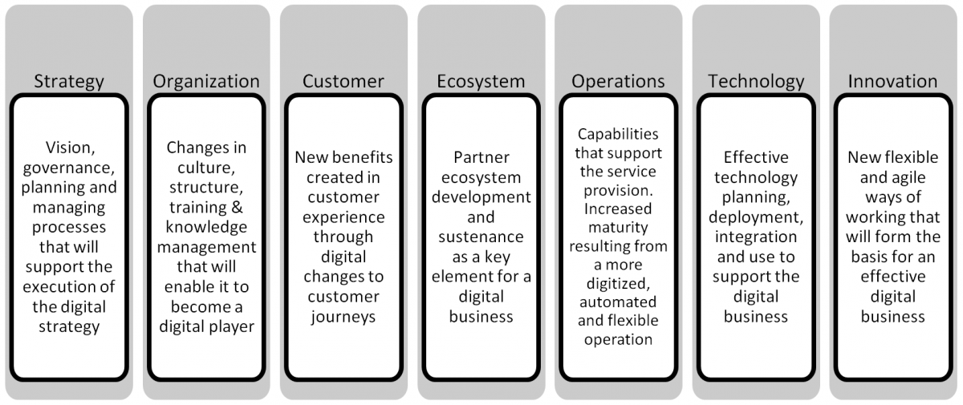
Customer: Focuses on customer participation and empowerment, as well as new benefits created in customer experience through digital transformation of customer journeys.
Technology: Represents the capabilities that enable effective technology planning, deployment, and integration to support the digital business.
Operations: Focuses on the capabilities that support the service provision. Increased maturity within this dimension demonstrates a more digitized, automated, and flexible operation.
Ecosystem: Signifies partner ecosystem development and sustenance as a key element for a digital business.
Innovation: Focuses on the capabilities that enable more flexible and agile ways of working that will form the basis for an effective digital business.
The Five Maturity Levels
The five levels represent the progression stages of an organisation in its digital transformation journey. Each level includes a set of characteristics that a business must demonstrate in terms of implementations, investments, or established capabilities in order to be situated at that particular level.
Each level builds on the previous one. As the organization implements and integrates the various changes that are pertinent to its digitization journey, the maturity rating would rise across the applicable dimensions.
FOR INTERNAL USE ONLY
WPA1-WK2p3

Slide 4
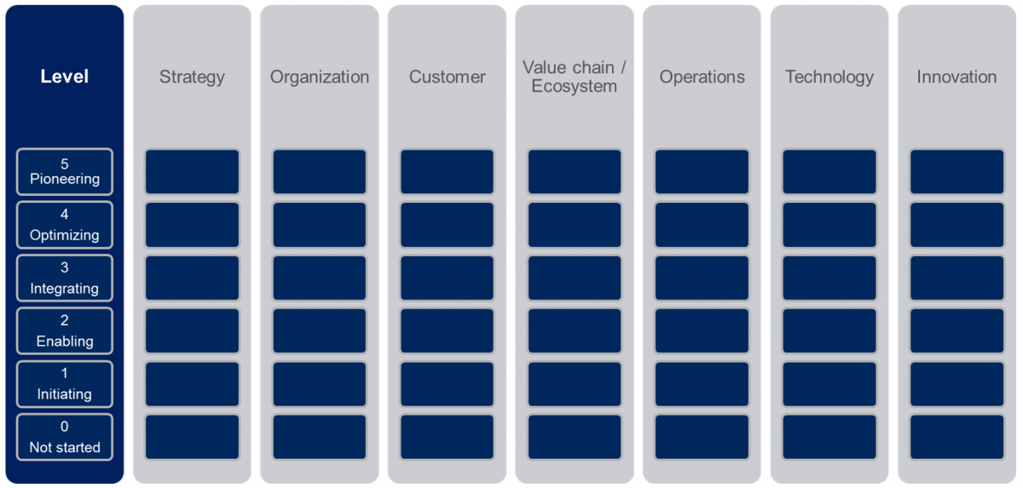
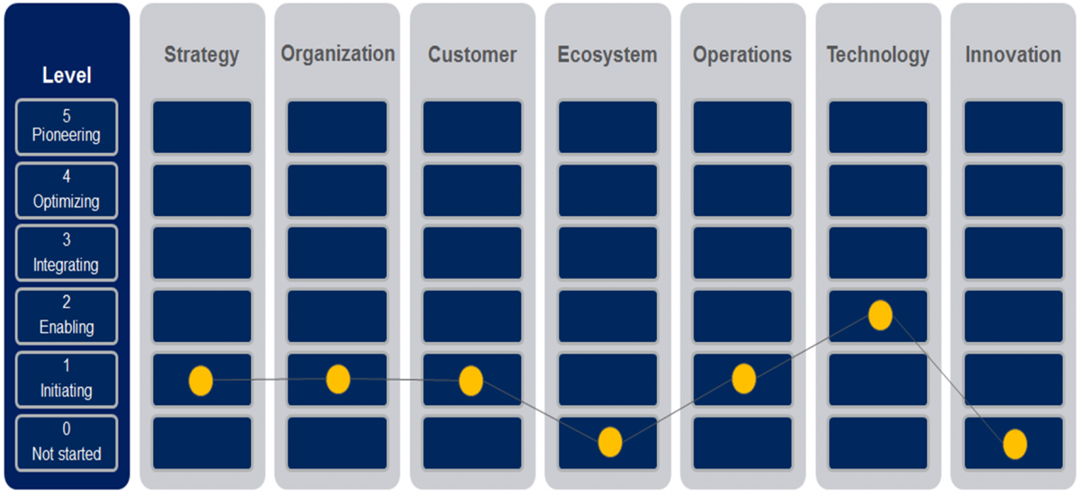
Maturity in each dimension is assessed across five levels (plus a default level zero reflecting a state of inaction). In order of decreasing maturity,
Pioneering: The organization is breaking new ground and advancing the state of the practice within the dimension.
Optimizing: The organization's digital initiatives within the dimension are being fine-tuned and used to further increase overall performance.
Integrating: The organization's initiatives are being integrated across the organization to support end-to-end capabilities.
Enabling: The organization is implementing initiatives within the dimension that will form the foundation of its digital business.
Initiating: The organization has decided to move
toward a digital business and is taking initial steps in
that direction.
0 Not started: The organization has not taken any steps to transform.
FOR INTERNAL USE ONLY
WPA1-WK2p4

Slide 5
DIGITAL TRANSFORMATION MATURITY PROFILE ASSESSMENT QUESTIONNAIRE
Instructions: Please analyse the current level of your company’s progress in each of the Five Dimensions (yellow highlight) of the DX Maturity Profile. Based on interviews with 2-3 senior leaders, check as many CHARACTERISTICS that apply in each level (1-5).
DIMENSION 1: STRATEGY
This dimension represents vision, governance, planning, and management processes that will support the implementation of the digital strategy.
Level 1 – Initiating: The organization has decided to move toward a digital business and is taking initial steps in that direction.
The organization has defined an initial digital vision, albeit at this point it is mostly "siloed" and focused on incremental operational improvements
Some proof-of-concept projects have been authorized at a departmental level to experiment with digital tools (e.g., self-service apps)
Level 2 – Enabling: The organization is implementing initiativeS that will form the foundation of its digital business.
A digital strategy that incorporates most elements of this digital maturity model is signed-off at CxO level
Formal investments aligned to the digital strategy have been approved
Digital leadership have been appointed to drive transformation
Budgets are incorporating digital targets
Level 3 – Integrating: The organization's initiatives are being integrated across the organization to support end-to-end capabilities.
A common digital strategy is shared across the whole organization at all levels
Investments have been authorised at CXO level for overall digital transformation
Digital initiatives are being implemented across the organization, including cross-departmental projects
Budgets, key performance indicators and performance metrics across the organization include a digital element, including common (inter-departmental) targets
First set of digital services are in the roadmap/delivered, including partnerships with digital vendors (e.g., fleet management, IaaS)
Digital revenues are now being specifically recorded, although these might not yet be particularly large
DIMENSION 1: STRATEGY
This dimension represents vision, governance, planning, and management processes that will support the implementation of the digital strategy.

Slide 6
Level 4- Optimising: The organization's digital initiatives within the dimension are being fine-tuned and used to further increase overall performance.
Digital strategy is well developed and drives the organization's direction and investments
Digital is a core competence in the organization
New business models are being implemented with pure dielements
Digital strategy is being shared and reviewed with all stakeholders, including external partners
Digital strategy is no longer owned by a dedicated team but it is an inherent part of activities across the organization
New digital services are becoming a significant share of total revenues (~ 5%).
Level 5- Pioneering: The organization is breaking new ground and advancing the state of the practice within the dimension.
The digital strategy has for some time been driving management and investment decisions.
The organization is now capitalizing on previous investments and transformation efforts to generate completely new revenue streams based on digital capabilities and digital business models.
Digital businesses provide sufficient revenue streams to enable continued investment in new digital initiatives
Digital services account for a significant (>10%) share of total revenues.
DIMENSION 2: ORGANISATION
This dimension focuses on changes in communications, culture, structure, training, and knowledge management within the organization that will enable it to become a digital player
Level 1 – Initiating: The organization has decided to move toward a digital business and is taking initial steps in that direction.
The organization has articulated the need for digital transformation.
The need for digital competencies has been identified and a general development plan is being defined.
Initial investments are being made to develop digital competencies, including training programs.
Recruitment of select "experts" to bring needed skills is ongoing, often in isolated teams.
Level 2 – Enabling: The organization is implementing initiatives within the dimension that will form the foundation of its digital business.
The organization has a vision for digital transformation, which begins to drive change towards a digitally- savvy workforce.
Digital units/teams are being created to explore digital opportunities.
Training and compensation schemes are being adapted to align with the digital strategy.
Digital services are supported by a specific sales team.
DIMENSION 2: ORGANISATION
This dimension focuses on changes in communications, culture, structure, training, and knowledge management that will enable the organization it to become a digital player

Slide 7
Level 3 – Integrating: The organization's initiatives are being integrated across the organization to support end-to-end capabilities.
Management is continuously communicating the digital strategy and advances in its implementation across the whole organization.
Digital strategy is driving corporate change, including organizational structure and key performance indicators.
Digital initiatives incorporate people from several functions and departments, as well as external partners.
Performance and compensation systems across the organization incorporate digital elements.
Global processes are set to promote the transfer of global/central digital knowledge towards the Operating Businesses (OpCos).
Level 4- Optimising: The organization's digital initiatives within the dimension are being fine-tuned and used to further increase overall performance.
Digital is fully embedded in the corporate culture.
Digital capabilities are well developed and partnerships are continuously formed to access new ones.
A well-defined personnel development strategy is in place, including when to train, outsource, or acquire digital capabilities.
Key performance indicators for sales are now mainly driven by digital services.
Level 5- Pioneering: The organization is breaking new ground and advancing the state of the practice within the dimension.
Collaboration with other ecosystem partners is well established, generating service innovation that is ahead of competition.
The organization is flexible and easily adapts to changes in the market in a more agile way than competitors.
The organization is focused on digital innovation.
DIMENSION 3: CUSTOMER
This dimension focuses on customer participation and empowerment, as well as new benefits created in customer experience through digital transformation of customer touch points.
Level 1 – Initiating: The organization has decided to move toward a digital business and is taking initial steps in that direction.
Basic self-help tools (e.g., online portals, forums) are available to customers.
Initial pilots of new digital tools such as self-service apps and social media support are being conducted.
Initiatives and requirements to expand customer interaction beyond basic app-based self-support have been identified.
Basic e-commerce capabilities are being implemented to drive calls to purchase online.
DIMENSION 3: CUSTOMER
This dimension focuses on customer participation and empowerment, and new benefits created in customer experience through digital transformation of customer touch points.

Slide 8
Level 2 – Enabling: The organization is implementing initiatives within the dimension that will form the foundation of its digital business.
An omni-channel vision has been fully articulated (although not necessarily completely executed).
New digital customer engagement tools are being implemented supporting the customer lifecycle.
Customer experience and usage data is actively collected and used to assist customer support and service improvements.
New digital services (typically from third parties) are being made available to customers, albeit not yet as part of an integral "multi-product" service.
Level 3 – Integrating: The organization's initiatives are being integrated across the organization to support end-to-end capabilities.
An omni-channel vision is well under-way throughout customer-facing operations (e.g., from physical shops through to online to mobile and call centres).
Customers cannot only access support and information; service self-configuration tools are also available across channels.
Customer experience and usage data is routinely collected across all channels and shared across organizational functions (e.g., marketing, product management, customer support, network operations).
Customers can bundle new digital services with traditional services.
Level 4- Optimising: The organization's digital initiatives within the dimension are being fine-tuned and used to further increase overall performance.
Customer experience management has moved from reactive to proactive including automated actions (e.g., next-best action, personalized promotions).
Data analytics are being extensively used to improve customer value, including development of new services offerings, promotions, and branding.
Digital tools and systems are enabling full customization of services at the individual customer level, including third-party products.
Initial tests of data-driven dynamic are is ongoing.
Level 5- Pioneering: The organization is breaking new ground and advancing the state of the practice within the dimension.
Dynamic pricing is being used to maximize customer value through full personalisation and flexibility.
Machine learning and other advanced tools are being used to identify consumption trends and to develop new services and pricing strategies that are entirely new to the industry.
New (including non-traditional telecommunication) digital services are being developed based on deep knowledge of customer (e.g., advanced analytics) and are, from inception, fully integrated across all touch points (e.g., one screen/app/bill for all services).

Slide 9
Level 1 – Initiating: The organization has decided to move toward a digital business and is taking initial steps in that direction.
The organization has developed a preliminary ecosystem strategy for digital services.
Programs and key assets (e.g., people, technology platforms) have been identified that will form the basis for a digital ecosystem.
Resources (e.g., people and funding) are being allocated to develop a digital ecosystem.
Level 2 – Enabling: The organization is implementing initiatives within the dimension that will form the foundation of its digital business. .
An ecosystem strategy, as part of a wider digital product strategy, has been signed-off by senior management. An initial group of partners has been on-boarded, albeit with limited integration of products and capabilities (e.g., on a re-seller model).
Tools and systems are being put in place to support a closer integration of partners, including service enablement platforms, APIs, and preferred pricing structures.
Level 3 – Integrating: The organization's initiatives are being integrated across the organization to support end-to-end capabilities.
The ecosystem strategy has evolved to focus on developing a two-sided model whereby value is created for both end customers and partners.
Integration with partners goes beyond basic product bundling or re-selling, including some resource sharing (e.g., joint market channels).
Investments in integration capabilities are being made to facilitate fast and efficient partner service development.
The organization is integrating partner services and capabilities to enhance existing products.
Level 4 - Optimising: The organization's digital initiatives within the dimension are being fine-tuned and used to further increase overall performance.
The ecosystem strategy has moved towards a digital marketplace where users can integrate services from various ecosystem parties.
Dedicated teams are in place to help develop partner capabilities (e.g., designating marketing resources to help partners to develop their promotions and go-to-market strategies).
Investments in integration and development capabilities are being made to not only enable but accelerate and reduce costs of service creation by partners in ecosystem.
Data flows across the ecosystem partners for product/service optimization.
DIMENSION 4: ECOSYSTEM
This dimension focuses on partner ecosystem development and fostering as a key element for a digital business

Slide 10
Level 5 - Pioneering: The organization is breaking new ground and advancing the state of the practice within the dimension
The ecosystem is mature and it starts producing innovations that cross organizational boundaries.
Products and services developed and launched in partnership with ecosystem partners are leading the market and are based on data-driven customer knowledge shared across partner organizations.
The organization is developing new revenue streams and business models that incorporate ecosystem partners from inception through to launch and operation.
DIMENSION 5: TECHNOLOGY
This dimension is focused on the capabilities that enable an effective technology planning, deployment, integration, and use to support the digital business.
Level 1 – Initiating: The organization has decided to move toward a digital business and is taking initial steps in that direction.
A digital-specific, IT architecture is being developed.
Efforts to define required transformation of IT architecture have been started.
Some initial pilots are planned to test new digital tools and platforms.
Level 2 – Enabling: The organization is implementing initiatives within the dimension that will form the foundation of its digital business.
A digital-specific IT architecture has been defined and changes to enterprise IT are ongoing to align it to target architecture. Tactical IT investment plans are aligned to target architecture.
Platforms are being deployed to support digital services (e.g., an Internet of Things, or IoT, platform).
An integral API and security strategy for supporting third-party services has been defined.
Support systems are being implemented to support digital services (e.g., flexible charging and billing).
There is a process to evaluate IT investments based on their alignment to the digital strategy of the organization.
Level 3 – Integrating: The organization's initiatives are being integrated across the organization to support end-to-end capabilities.
Digital enterprise IT architecture has been largely implemented, including consolidation of stove-pipe systems into platforms for support of omni-channel and third-party services.
Third-party services are being integrated and supported by digital enterprise IT architecture and related tools.
Processes across the organization (e.g., customer support, partner onboarding) are aligned to digital IT architecture.
Analytics technologies are being implemented to facilitate data collection and sharing across functions.
DIMENSION 5: TECHNOLOGY
This dimension is focused on the capabilities that enable an effective technology planning, deployment, integration, and use to support the digital business.

Slide 11
Level 4 - Optimising: The organization's digital initiatives within the dimension are being fine-tuned and used to further increase overall performance.
End-to-end processes supporting digital services are being optimized by leveraging the digital enterprise IT architecture.
Integration tools are deployed to reduce time and costs of integration of third-party services.
Digital IT architecture supports business agility through flexible tools and supporting processes.
Analytics technologies are being used for optimization of services and processes.
Automation of processes using real-time data processing is being used for proactive decision making across the organization.
Level 5 - Pioneering: The organization is breaking new ground and advancing the state of the practice within the dimension.
Technologies such as advanced data analytics underpin innovation processes across the organization, from new service development through to service assurance to customer support.
Automation throughout the organization drives superior performance (e.g., speed, reliability, ARPU, NPS) compared to industry peers.
Tools using technology such as machine learning are implemented and used across the organization (and even to ecosystem partners) for predictive activities (e.g., service reliability, user consumption trends) that support digital business innovation.
DIMENSION 6: OPERATIONS
This dimension focuses on the capabilities that support the service provision. Increased maturity within this dimension demonstrate a more digitized, automated, and flexible operation.
Level 1 – Initiating: The organization has decided to move toward a digital business and is taking initial steps in that direction.
Investments to automate key operations that support digital services (e.g., service provisioning, charging, and billing) are being evaluated.
Improvements in network visibility and automation are being evaluated.
Initiatives to update key business processes to support digital services have been identified.
Level 2 – Enabling: The organization is implementing nitiatives within the dimension that will form the foundation of its digital business.
Systems to support and automate digital services are being implemented.
Advanced analytics are being deployed for service assurance improvements.
Systems and processes to collect and analyze customer usage data are being deployed.
Processes and policies to better support digital services are being designed and implemented in some key areas of the organization (e.g., ordering, fulfillment, partner management).
DIMENSION 6: OPERATIONS
This dimension focuses on the capabilities that support the service provision. Increased maturity within this dimension demonstrate a more digitized, automated, and flexible operation.

Slide 12
Level 3 – Integrating: The organization's initiatives are being integrated across the organization to support end-to-end capabilities.
Automation of end-to-end processes is being implemented to support digital services.
Network data is being actively collected, including user- and partner-contributed data, to improve network visibility and to assist expansion planning.
Processes and systems are in place to support integration of third-party digital services.
Network, customer, and other usage data is being collected and combined to provide visibility of end-to-end processes across the organization.
Digital services are implemented and deployed jointly with traditional ones, and they share processes.
Level 4 - Optimising: The organization's digital initiatives within the dimension are being fine-tuned and used to further increase overall performance.
Automated processes are being optimized to improve efficiency and reduce costs of designing, provisioning, and supporting of digital services, including partner services.
Real-time network, customer, and usage data is being combined and analyzed to optimize service reliability as well as key processes (e.g., customer support).
Some real-time, automated decision making is being implemented in the service provision of digital services (e.g., if the event of service failure, send job order and customer-personalized message).
Level 5 - Pioneering: The organization is breaking new ground and advancing the state of the practice within the dimension.
Full observability of service and usage data is now driving innovation within the organization, including dynamic offerings to both customers and partners.
Automated end-to-end processes ensure real-time data flows across functions for improved planning and decision-making.
Real-time, automated decision-making is fully implemented in the service provision of digital services.
DIMENSION 7: INNOVATION
This dimension focuses on the capabilities that enable more flexible and agile ways of working that will form the basis for an effective digital business.
Level 1 – Initiating: The organization has decided to move toward a digital business and is taking initial steps in that direction.
A need to develop a more agile and innovative organization has been identified.
The organization is developing a strategy for digital innovation across functions.
Some initial changes are being made to the way digital services are developed with a focus hitherto on incremental improvements.
DIMENSION 7: INNOVATION
This dimension focuses on the capabilities that enable more flexible and agile ways of working that will form the basis for an effective digital business.

Slide 13
Level 2 – Enabling: The organization is implementing initiatives within the dimension that will form the foundation of its digital business.
A digital innovation strategy has been developed with focus on agile development and open
and data-driven innovation processes.
Investments in digital technologies are aligned to innovation strategy and activities.
New processes are being implemented to foster digital innovation.
Investments in people development for digital innovation are underway.
Level 3 – Integrating: The organization's initiatives are being integrated across the organization to support end-to-end capabilities.
Open innovation with external parties including partners, users, and others has been implemented to support digital innovation.
Data (including service, customer, and usage) is shared across the organization (and to partners) to support innovation.
Metrics and key performance indicators specific to digital innovation and partner integration are being implemented.
Level 4 - Optimising: The organization's digital initiatives within the dimension are being fine-tuned and used to further increase overall performance.
Innovation in new digital services is mature, with clearly defined targets, processes, and performance metrics.
Time to market of new service propositions is being reduced through well-established innovation processes.
Customer and partner co-creation of new services is used to advance innovation and reduce costs of development.
Level 5 - Pioneering: The organization is breaking new ground and advancing the state of the practice within the dimension.
The organization is breaking new ground in the way it innovates, establishing innovation processes that are new to the industry.
The organization is recognized in the industry as leader in digital innovation.
New digital services launched in the last 3 years account for a significant share of total digital revenues (e.g., >30%)

Slide 14
SUMMARISE YOUR OVERALL RATINGS FOR THE 7 DIMENSIONS
*** To Be Submitted To EMDT Program Adviser***
Name of Organisation: ________________________
Rated By: ___________________________________
Date Submitted: ______________________________
INSTRUCTIONS: Please put a CHECK MARK (inside the box) that corresponds to the OVERALL RATING that you gave your company based on your analysis of the characteristics of your current digital practices. Check only ONE box for each of the Seven Dimensions of digital maturity profile.
DIMENSION 1: STRATEGY
Initiating
Enabling
Integrating
Optimising
Pioneering
DIMENSION 1: STRATEGY
Initiating
Enabling
Integrating
Optimising
Pioneering
DIMENSION 1: STRATEGY
Initiating
Enabling
Integrating
Optimising
Pioneering
DIMENSION 1: STRATEGY
Initiating
Enabling
Integrating
Optimising
Pioneering
DIMENSION 1: STRATEGY
Initiating
Enabling
Integrating
Optimising
Pioneering
DIMENSION 1: STRATEGY
Initiating
Enabling
Integrating
Optimising
Pioneering
DIMENSION 1: STRATEGY
Initiating
Enabling
Integrating
Optimising
Pioneering

Slide 15
PLOT YOUR COMPANY’S DX MATURITY PROFILE
INSTRUCTIONS: Please put an “X” on the BOX that represents your overall rating under each of the Seven Dimensions of the DX Maturity Profile.
ANSWER THE REFLECTION GUIDE QUESTIONS
(Write down your thoughts on the three questions below)
Based on the summary results above, what are the TOP 2-3 Key Strengths of your DX Maturity Profile? Explain your answer.
_____________________________________________________________
____________________________________________________________________________________________
_________________________________________________________________
On the other hand, what are the LOWEST 2-3 Key Weaknesses of your DX Maturity Profile? Explain why you think they exist.
_________________________________________________________________
_________________________________________________________________
_________________________________________________________________
What are your 2-3 TOP Recommended Actions build on your strengths or to address your weaknesses? __________________________________________________
__________________________________________________
__________________________________________________

